Slide 1

Version 2.0: October 2023

Slide 2
Agenda
Introduction
Vesting in the Thrift Savings Plan (TSP)
Why Save for Retirement?
Blended Retirement System (BRS) Overview
Understanding the TSP
Summary and Resources

Slide 3
What Does Vesting Mean?

Slide 4
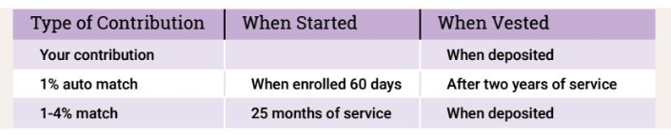
What Does Vesting Mean?
Being vested = having ownership
You are always vested in, or entitled to, your own contributions and earnings.
To become vested in the Service Automatic (1%) contribution, you must have completed two years of service.

Slide 5
When Am I Vested?
Serving as of December 31, 2017
  Opted into BRS
  Receive Service Automatic (1%) and Matching Contributions immediately
  After 2 years of service from PEBD, vested in Service Automatic (1%) Contributions
Joined on or after January 1, 2018
  Automatically enrolled in BRS
  Service Automatic (1%) Contributions begin after 60 days
  After 2 years of service:
    Vested in the Service Automatic (1%) Contributions
    Begin receiving up to 4% of Matching Contributions

Slide 6
Why Save for Retirement?

Slide 7
Reasons to Save
Retirement can be expensive
  Pension may not be an option or not enough
  Social Security benefits may not be enough
  Health and longevity
  Inflation
Investing can be easy
  Time builds wealth
  Service Automatic (1%) and Matching Contributions
  Potentially greater returns than saving
  Benefits of compound interest

Slide 8
Time = Money
Start early and continue
Soldier | Start Age | Monthly Investment | Total Invested | Total Earned*
Pressy Mandi Steve | 20 25 35 | $200 $200 $200 | $108,000 $96,000 $72,000 | $1,054,908 $698,202 $298,072
*Assuming an 8% Rate of Return to age 65

Slide 9
Blended Retirement System (BRS)
Overview

Slide 10
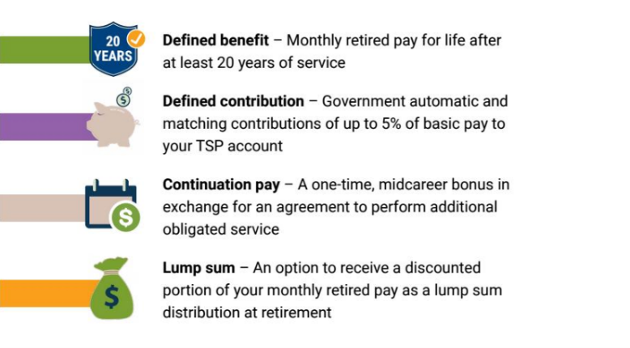
The Four Components of BRS
DoD Automatic
1% into TSP
Soldier’s TSP Contributions
DoD
Automatic 1% into TSP
DoD Matching
TSP up to 4%
Continuation Pay
Monthly
Retired Pay
Includes lump sum option
TSP
Earnings

Slide 11
Understanding the
Thrift Savings Plan (TSP)

Slide 12

What Is the Thrift Savings Plan?
• Defined Contribution Plan (TSP)
  Open to all military members and federal employees
  Similar to a civilian 401(k)
• Service Automatic (1%) and Matching Contributions under BRS
  Service Automatic (1%) Contribution
  Up to 4% Matching Contribution
  Until you reach 26 years of service

Slide 13
Total Contributions
You Contribute | Automatic (1%) Contribution | Army Matching Contribution | Total Contributions
0% | 1% | 0% | 1%
1% | 1% | 1% | 3%
2% | 1% | 2% | 5%
3% | 1% | 3% | 7%
4% | 1% | 3.5% | 8.5%
5% | 1% | 4% | 10%
Greater than 5% | 1% | 4% | Your contribution +5%

Slide 14
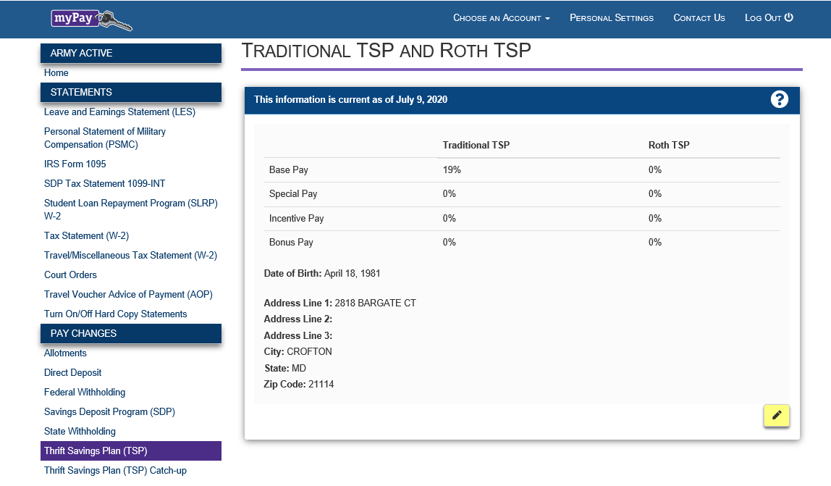
Changing TSP Elections

Slide 15
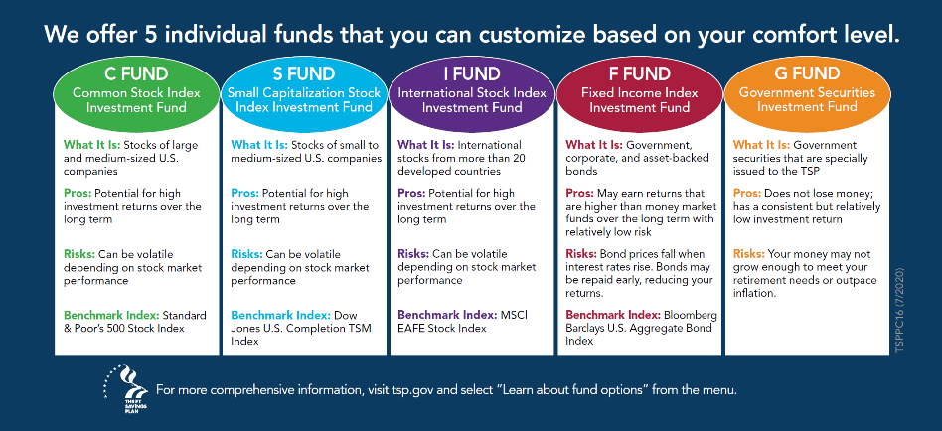
Five Core TSP Funds

Slide 16
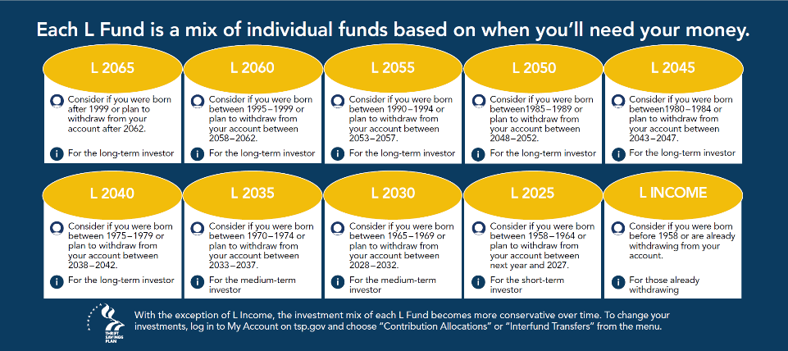
Lifecycle Funds

Slide 17
TSP Benefits and Contribution Limits
Benefits
  Automatic deduction from pay
  Service Automatic (1%) and Matching Contributions
  Traditional and Roth options
  Many investment funds
  Minimal administrative fees and expenses
Contribution Limits
  Elective Deferral
  Annual Additions Limit
  Catch-up provision for those over age 50
  Designated Combat Zone

Slide 18
Evaluate Your Retirement Goals
Evaluate Annually
  Increase your TSP contributions
  Goals, time horizon, risk tolerance and fund selection aligned
Analyze your spending plan
  How much can you afford to save
  Contribute at least 5% of base pay to maximize benefits
Revisit
Revise

Slide 19

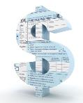
Tax Treatment Options
Tax Break Now
Tax Break Later
Traditional TSP
You get your tax break upfront and pay no taxes on the money you put in until you withdraw it.
Roth TSP
The money you deposit has already been taxed. You pay no taxes when you make withdrawals after age 59 ½.

Slide 20
How to Access and Manage the TSP

Slide 21

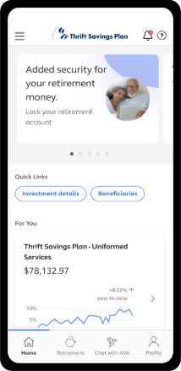
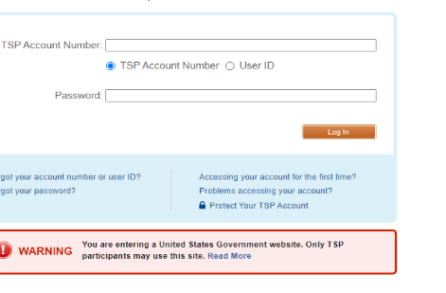
How to Access and Manage TSP
myPay.dfas.mil
  Start – stop – change
    Percentage of pay
    Type (Traditional / Roth)
  Update address
tsp.gov
  View portfolio
  Manage investments
  Change allocations
  Review beneficiaries (update with Form TSP-3)
TSP Mobile App
  Convenience and security
  Virtual Assistant
  Manage your account

Slide 22
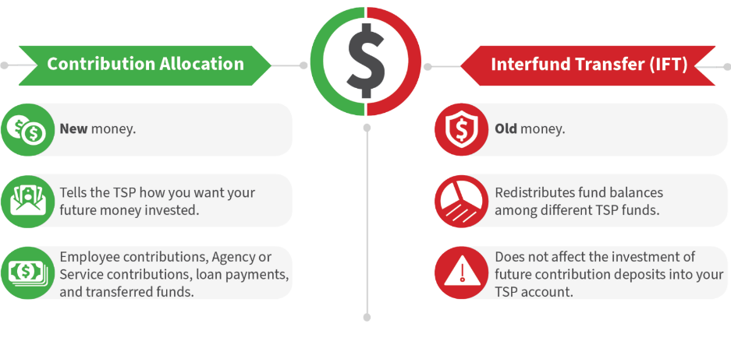

How do I Move My TSP Money into Different Funds?
Investment Election
Reallocation
Fund transfer

Slide 23
Summary and Resources

Slide 24
Summary
Let’s recap what you learned about:
  Vesting in the Thrift Savings Plan (TSP)
  Why Save for Retirement?
  Blended Retirement System (BRS) Overview
  Understanding the TSP
  How to Access and Manage TSP

Slide 25



Resources and Conclusion

Slide 26
Thank You!

